Slide 1

SWD 392 - Software Architecture and Design

Slide 2
SWD392
Overview of Software Modeling and Design Method

Slide 3
Introduction
This chapter provides an overview of the software modeling and design method, including requirements modeling, analysis modeling, and design modeling. An overview of the different kinds of software architectures addressed in this textbook is given.

Slide 4
Table of contents
Requirements, analysis, and design modeling
00
COMET use case–based software life cycle
01
Comparison of the COMET life cycle with other software processes
02
Overview
03
Designing software architectures
04
05
Summary

Slide 5
Overview
COMET: Collaborative Object Modeling and Architectural Design Method
COMET is an iterative use case–driven and object-oriented method
COMET uses the UML notation
COMET = UML + Method

Slide 6
01
COMET use case–based software life cycle

Slide 7
The COMET use case–based software life cycle model is a highly iterative software development process based around the use case concept.
In the requirements model: functional requirements are described in terms of actors and use cases. Each use case defines a sequence of interactions between one or more actors and the system.
In the analysis model: the use case is realized to describe the objects that participate in the use case and their interactions.
In the design model: the software architecture is developed, describing components and their interfaces.

Slide 8
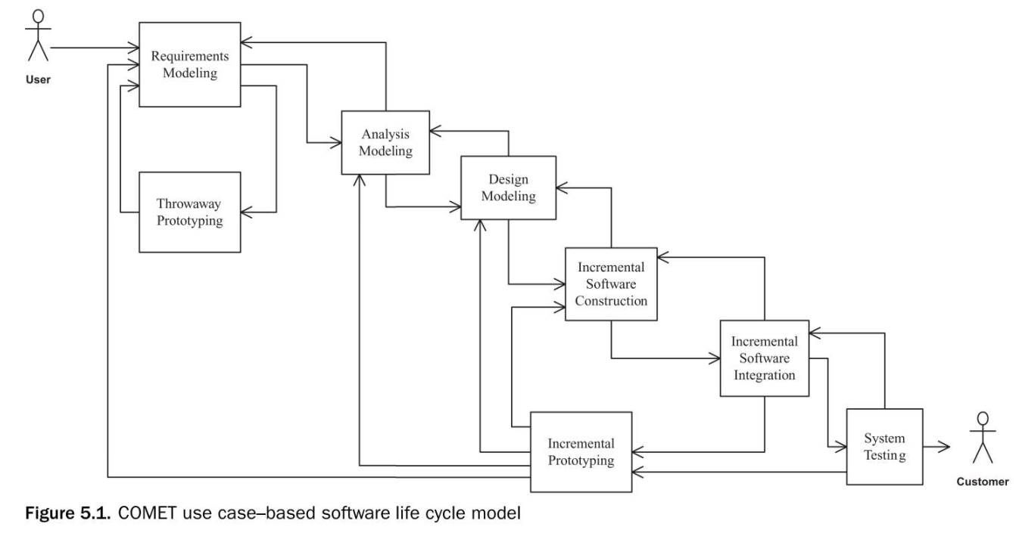
The COMET method ties in the three phases of requirements, analysis, and design modeling by means of a use case-based approach

Slide 9
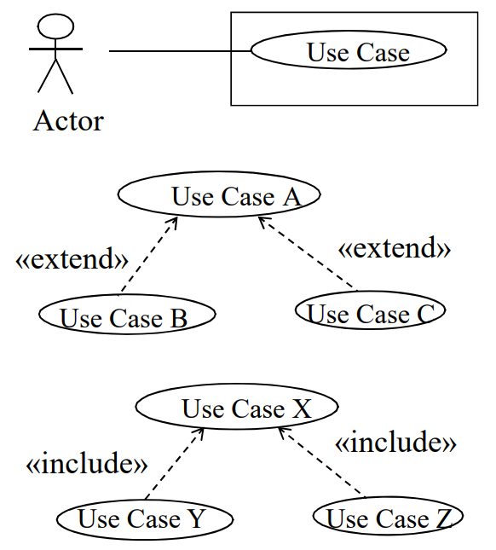
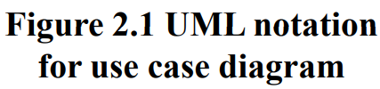
5.1.1 Requirements Modeling
During the requirements modeling phase, a requirements model is developed in which the functional requirements of the system are described in terms of actors and use cases.

Slide 10
5.1.2 Analysis Modeling
  Analysis Modeling consists of
  Static Modeling
  Dynamic Modeling

Slide 11
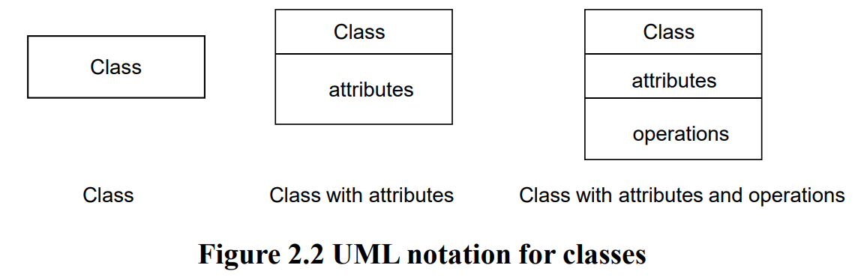
5.1.2 Analysis Modeling
Static Modeling
Defines the structural relationships among problem domain classes.
The classes and their relationships are depicted on class diagrams.
Object structuring criteria are used to determine the objects to be considered for the analysis model.

Slide 12
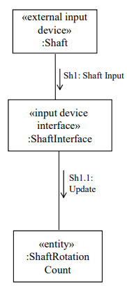
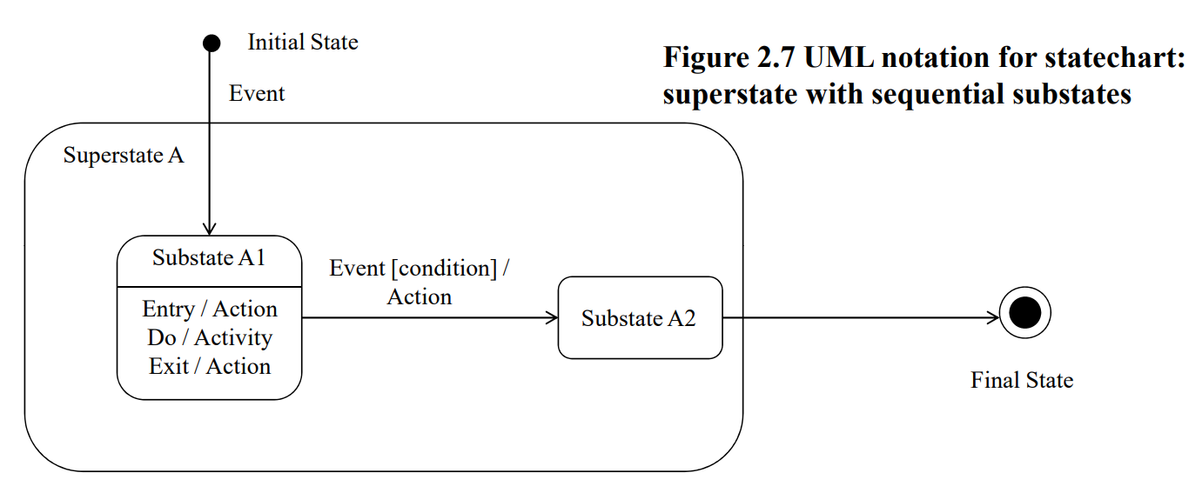

5.1.2 Analysis Modeling
Dynamic Modeling
Define statecharts for state dependent control objects
Defines how objects participate in use cases using communication diagrams or sequence diagrams

Slide 13
5.1.3 Design Modeling
In the design modeling phase, the software architecture of the system is designed, in which the analysis model is mapped to an operational environment.
The analysis model, with its emphasis on the problem domain, is mapped to the design model, with its emphasis on the solution domain.
For sequential systems, the emphasis is on the object-oriented concepts of information hiding, classes, and inheritance.

Slide 14
5.1.4 Incremental Software Construction
After completion of the software architectural design, an incremental software construction approach is taken.
This approach is based on selecting a subset of the system to be constructed for each increment.
Incremental software construction consists of the detailed design, coding, and unit testing of the classes in the subset.
This is a phased approach by which the software is gradually constructed and integrated until the whole system is built.

Slide 15
5.1.5 Incremental Software Integration
During incremental software integration, the integration testing of each software increment is performed.
The integration test for the increment is based on the use cases selected for the increment.
Integration testing is a form of white box testing, in which the interfaces between the objects that participate in each use case are tested

Slide 16
5.1.6 System Testing
System testing includes the functional testing of the system – namely, testing the system against its functional requirements.
Any software increment released to the customer needs to go through the system testing phase.

Slide 17
02
Comparison of the COMET life cycle with other software processes

Slide 18
5.2.1 Comparison of the COMET Life Cycle with Unified Software Development Process
The USDP provides considerable detail about the life cycle aspects and some detail about the method to be used.
The workflows of the USDP are the requirements, analysis, design, implementation, and test workflows.
Each phase of the COMET life cycle corresponds to a workflow of the USDP.
The COMET incremental software construction activity corresponds to the USDP implementation workflow.

Slide 19
5.2.2 Comparison of the COMET Life Cycle with the Spiral Model
The COMET method can also be used with the spiral model (Boehm 1988).
During the project planning for a given cycle of the spiral model, the project manager decides what specific technical activity should be performed in the third quadrant, which is the product development quadrant.
The selected technical activity, such as requirements modeling, analysis modeling, or design modeling, is then performed in the third quadrant
The risk analysis activity, performed in the second quadrant, and cycle planning, performed in the fourth quadrant, determine how many iterations are required through each of the technical activities.

Slide 20
03
Requirements, analysis, and design modeling

Slide 21
The UML notation supports requirements, analysis, and design concepts.
The COMET method described in this book separates requirements activities, analysis activities, and design activities.
COMET differentiates analysis from design as follows:
1: Analysis is breaking down or decomposing the problem so it is understood better;
2: Design is synthesizing or composing (putting together) the solution.

Slide 22
5.3.1 Activities in Requirements Modeling
In the requirements model, the system is considered as a black box. The use case model is developed.
Use case modeling. Define actors and black box use cases.
  The use case descriptions are a behavioral view; the relationships among the use cases give a structural view.
  Addressing nonfunctional requirements is also important at the requirements phase.

Slide 23
5.3.2 Activities in Analysis Modeling
In the analysis model, the emphasis is on understanding the problem; hence, the emphasis is on identifying the problem domain objects and the information passed between them.
In the analysis model, the analysis of the problem domain is considered. The activities are as follows:
  Static modeling
  Object structuring
  Dynamic interaction modeling
  Dynamic state machine modeling

Slide 24
5.3.3 Activities in Design Modeling
In the design model, the solution domain is considered. During this phase, the analysis model is mapped to a concurrent design model.
      Integrate the object communication model.
      Make decisions about subsystem structure and interfaces.
      Make decisions about what software architectural and design patterns to use in the software architecture.
      Make decisions about class interfaces, in particular for sequential software architectures.
      Make decisions about how to structure the distributed application into distributed subsystems, in which subsystems are designed as configurable components, and define the message communication interfaces between the components.
      Make decisions about the characteristics of objects, particularly whether they are active or passive.
      Make decisions about the characteristics of messages, particularly whether they are asynchronous or synchronous

Slide 25
04
Designing software architectures

Slide 26
During software design modeling, design decisions are made relating to the characteristics of the software architecture.
  Object-Oriented Software Architectures.
  Client/Server Software Architectures.
  Service-Oriented Architectures.
  Distributed Component-Based Software Architectures.
  Real-Time Software Architectures.
  Software Product Line Architectures.

Slide 27
05
Summary

Slide 28
This chapter described the COMET use case–based software life cycle for the development of UML-based object-oriented software applications.
It compared the COMET life cycle with the USDP and the spiral model, and described how the COMET method can be used with either the USDP or the spiral model.
The chapter then described the main activities of the COMET method and concluded with a description of the steps in using COMET. Each of the steps in the COMET method is described in more detail in the subsequent chapters of this textbook.

Slide 29
Thanks!

